Slide 1

HeartGuard: Early Detection of Heart Disease
DSC 680 Applied Data Science
Chitramoy Mukherjee, T301 T302 2253 Winter 2025

Slide 2
Introduction
HeartGuard is an innovative project that leverages Artificial Intelligence (AI) and Machine Learning (ML) to enable early detection of heart disease. By analyzing health metrics and lifestyle factors, HeartGuard aims to provide accurate predictions and personalized health plans, ultimately improving patient outcomes and reducing healthcare costs.
Problem Statement
Heart disease remains a leading cause of mortality worldwide, with millions of people affected each year. Traditional methods of detecting heart disease often occur at later stages, resulting in costly treatments and poorer patient outcomes.
There is a critical need for early detection and preventive care to mitigate the risks associated with heart disease. HeartGuard addresses this need by utilizing advanced AI/ML techniques to predict the likelihood of heart disease in individuals, allowing for timely interventions and personalized health plans.

Slide 3
Background and Data Sources
The increasing prevalence of heart disease poses significant challenges to healthcare systems globally. Factors such as aging populations, sedentary lifestyles, and unhealthy diets contribute to the rising incidence of cardiovascular conditions. Early detection and intervention are key to reducing the burden of heart disease. HeartGuard aims to revolutionize heart disease detection by employing AI/ML models to analyze comprehensive health data, identify high-risk individuals, and recommend preventive measures.
Heart_Disease_Classification_Dataset.csv from https://www.gigasheet.com/sampledata/heart-disease-classification-dataset
Cardiovascular_Disease_Dataset.csv from https://data.mendeley.com/datasets/dzz48mvjht/1
Heart_disease.csv from
https://www.kaggle.com/datasets/mirzahasnine/heart-disease-dataset/data

Slide 4
Methods/Steps
Data Preparation
Feature Selection and Engineering
Exploratory Data Analysis (EDA)/ Visualizations
Train-Test Split
Machine Learning Algorithms
Model Training and Evaluation
Model Comparison
Deployment and Monitoring

Slide 5
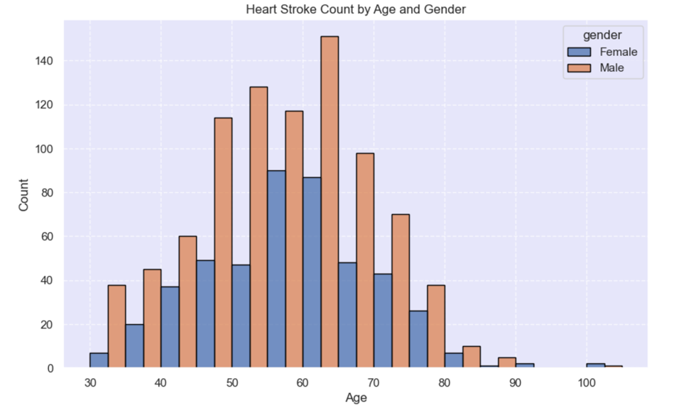
Heart Stroke Count by Age and Gender
The histogram plot is used to visualize the heart stroke count based on age and gender. Overall Male count of getting heart stroke is higher than Female count. Male with age group 50 - 70 years old have encountered maximum heart strokes. Male plotting is a bimodal distribution. Female plotting is a normal distribution and Female with age group 60 years old have encountered maximum heart strokes as compared to other female population.

Slide 6
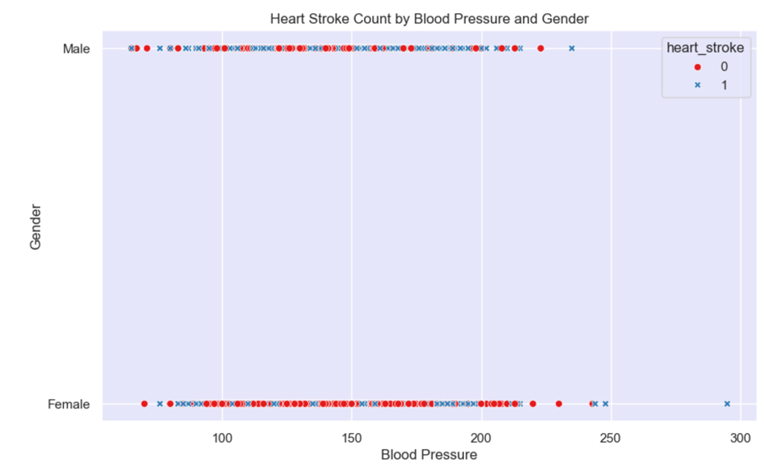
Heart Stroke Count by Blood Pressure and Gender
Attached plot is shows that in ‘Male’ gender, heart stroke is more prevalent with blood pressure > 150 ( in mm HG) where ‘Female’ gender is not showing significant correlation with increased blood pressure. This visualization indicates that chances of having heart stroke is high in ‘Male’ gender with increased blood pressure.

Slide 7
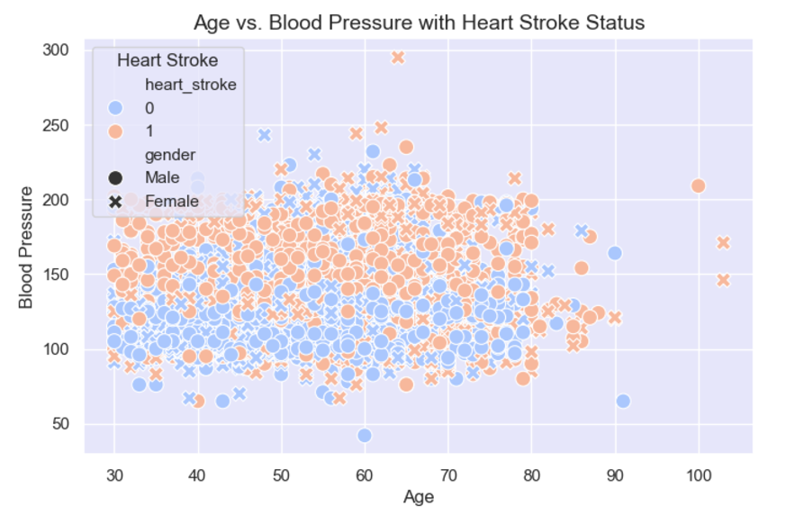
Age vs. Blood Pressure with Heart Stroke Status
Attached scatterplot visualizes the relationship between age and blood pressure, with points color-coded by heart stroke status and styled by gender. This allows for identifying patterns or trends, such as how age and blood pressure vary with stroke risk, while distinguishing between genders. The "coolwarm" palette highlights variations in stroke presence.

Slide 8
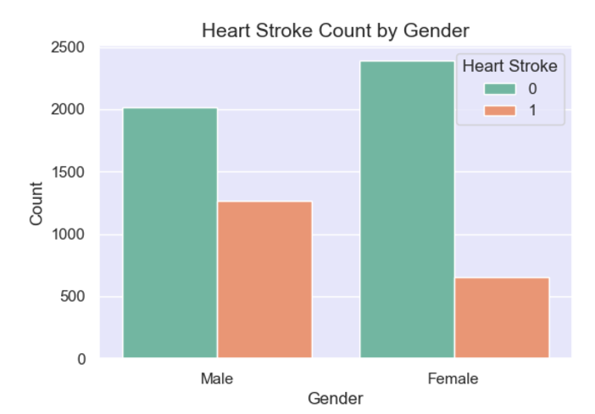
Heart Stroke Count by Gender
The counterplot displays the distribution of heart stroke cases by gender, with bars segmented by stroke status (e.g., presence or absence of a stroke) using the "Set2" color palette. It provides a clear comparison of stroke occurrence across genders. This visualization helps identify any gender-based differences in heart stroke prevalence.

Slide 9
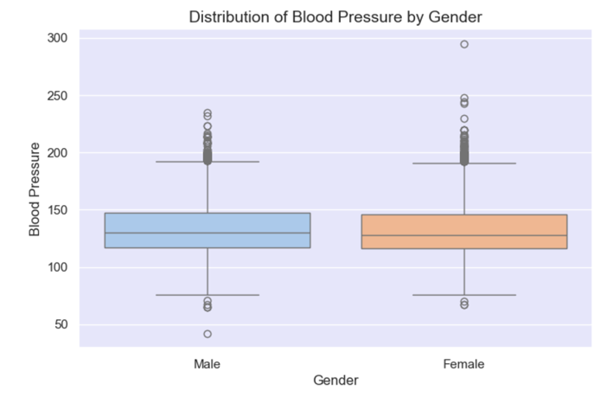
Distribution of Blood pressure by Gender
The boxplot illustrates the distribution of blood pressure values for each gender, highlighting key statistics like median, interquartile range, and potential outliers. Using the "pastel" palette, it visually compares blood pressure trends between genders. This helps in identifying gender-based differences in blood pressure levels.

Slide 10
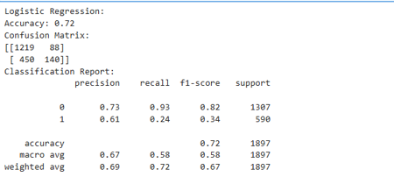
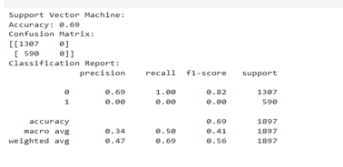
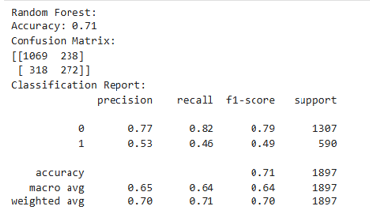
Outcome of Different Models

Slide 11
Thanks!!!

